Slide 2

“Terra Trek”
“Terra Trek”
Group name: ”Cyan”
Munim Ahemd (192-35-477) 34%
Tisha Khandokar (192-35-459) 33%
Afifa Hossain (192-35-453) 33% Date:27/08/2020

Slide 3

“Terra Trek“ Helps and procceses us to make a good trip.For those we connected An agent and Tourist each other. Our motto, ”Travelling is pleasant.”

Slide 4
Software User:
2 types of user profile will be there.
Agent user
Tourist user
Agent user :This user will provide such kind of service what’s tourist demand! Tourist user:And this user will take the service of agent.Also they can be added anything of the service.

Slide 5
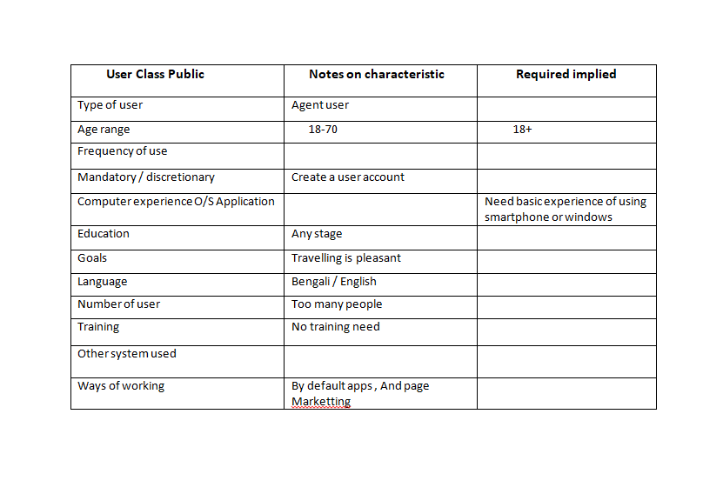
Agent profile:

Slide 6
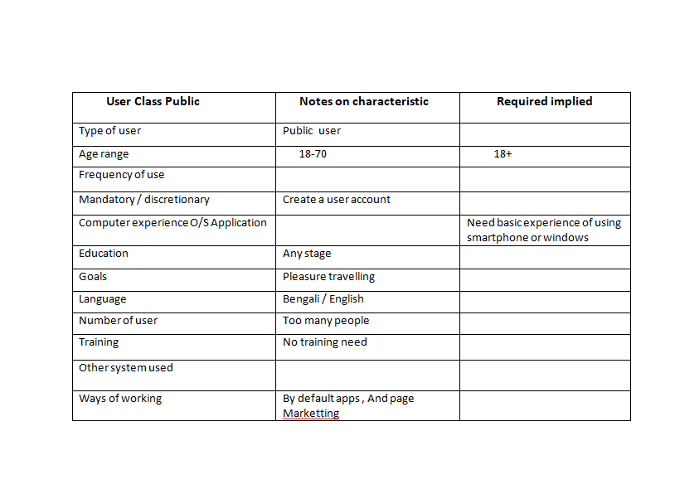
Tourist profile:

Slide 7
Functional :
1.People can visit the apps by their accounts. 2.Sharing location and different services. 3.Agent and public user can communicate with each other. 4.Agent can upload and Public user can view the all of their tour managing system from start to end. 5.They have different kind of option to choose.

Slide 8
Non-Functional:
1.In home page search bar will be added. 2.By booking or taking packs notification system will be alarming. 3.A guideline can be a man of yours local area. 4.Some written information and data will be add for good trip.

Slide 9
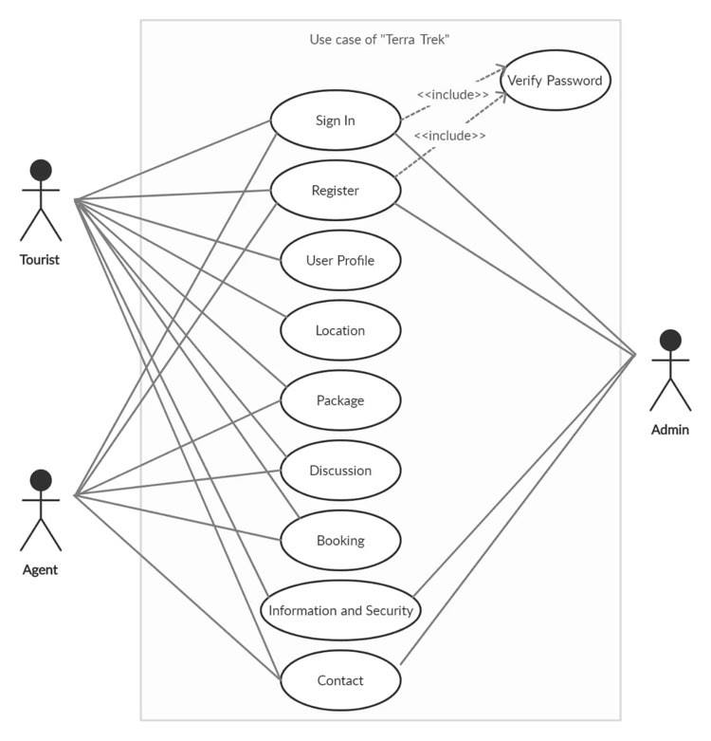
Use-case diagram:

Slide 10
Storyboard of ‘Terra Trek’

Slide 11
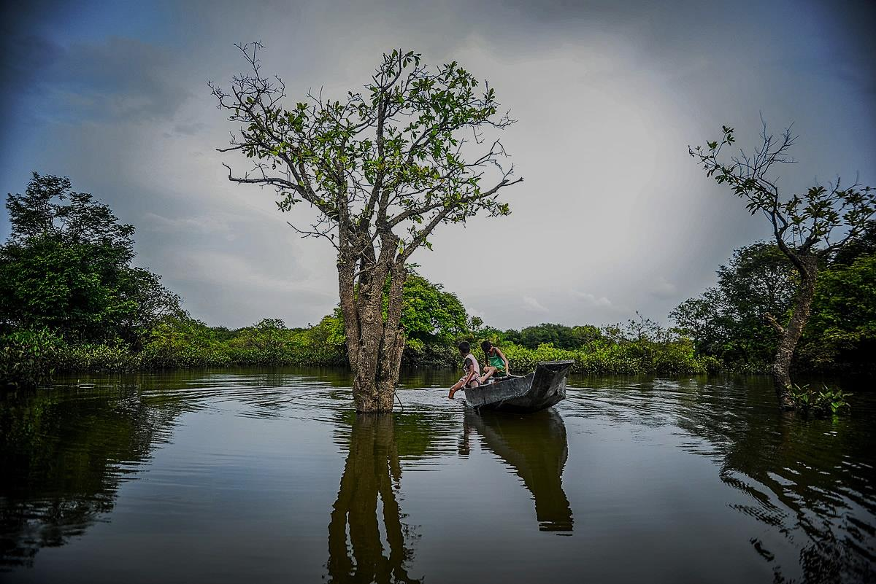
Agent
T
Tourist
A`

Slide 12


Agent
T
T
Tourist
A`
Username
Password
Log in
Name
Email
Password
NID/Birth Certificate/
Register

Slide 13
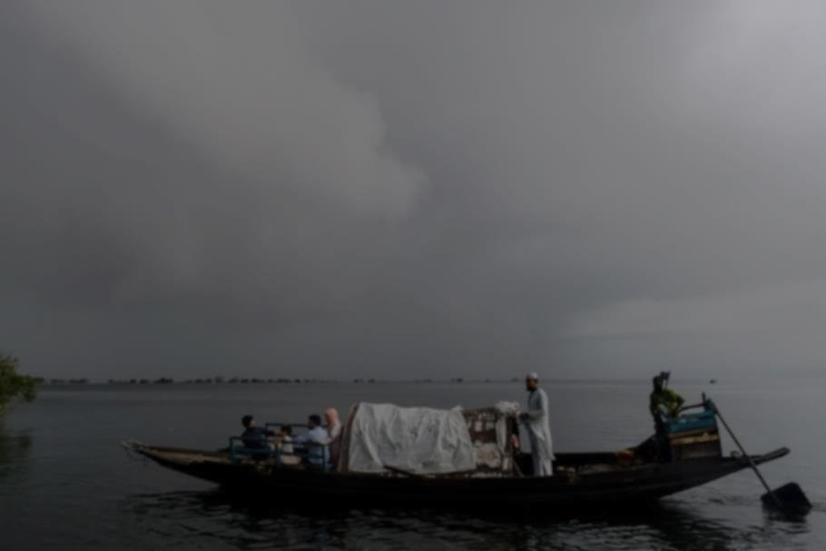
Agent
Agent
T
T
Tourist
A`
Username
Password
Log in
Name
Email
Password
NID/Birth Certificate/
Register

Slide 14





Ask
User
Home
About
Contact

Slide 15



Ask
User
My Trip
Bonus point
Name
Photo Album
Email
Favourite
Settings
Home
About
Contact

Slide 16


Location
Booking
Package
Information&Security
Discussion
Home

Slide 17
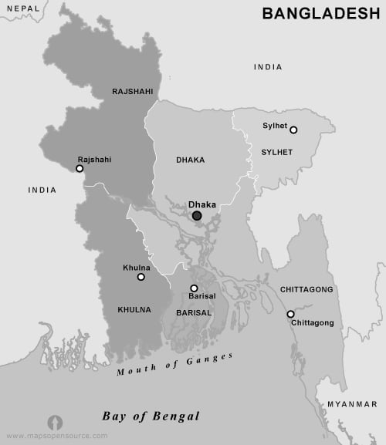





Slide 18

Sylhet
Area for trip: Srimongol.Shah Poran Majar,Ratargul,Bichanakandi,Lalakhal, Jaflong,Panthumai. Photo: //Photo.link Video: //Video.link
Home

Slide 19
Pack 1
Pack 2
Pack 3
Location: A,X,Y,Z(4)
Location: X,Y,Z(3)
Location: X,Y,Z(3)
Service: 1,2
Service: 1,2
Service: 2,3
Price:4,500/- (5% Discount)
Price:4 Price:4000/- (5% Discount)
Price:3,500/- (5% Discount)
+Add
Service: 1.Transport,Hotel,Food,Sightseeing,Photography,Guideline 2.Transport,Hotel,Food,Sightseeing,Photography 3.Transport,Hotel,Food,Sightseeing

Slide 20

pACK
Pack 1
+ Add Service
Location: A,X,Y,Z(4)
+Add Location
Service: 1,2
Service: 1.Transport,Hotel,Food,Sightseeing,Photography,Guideline 2.Transport,Hotel,Food,Sightseeing,Photography 3.Transport,Hotel,Food,Sightseeing
Home

Slide 21

Discussion
Ask
Open Text!
User
Chat
+
Call
Cell: 018……… 019………. Email: terratrek11@gmail.com

Slide 22

Booking
Division: Pack: Pack No: Price: Personal Details Name: Address: Mobile: Mail:

Slide 23
Members Information
Members List/Name: Amount: Date: Payment Method:
Payment System
Total Amount
Pay Now (70%)
Pay later(30%)
Bkash/Rocket
Card pay
Confirm

Slide 24
Information
Information about this trip: //Confirmation Info..
About all of your trip: //User all trip
Security
NID/Birth Certificate No: 1809-2304-xxxx-xxxx NID/Certificate File(png/jpg):
+File
Home

Slide 25

About us
“Terra Trek“ Helps and procceses us to make a good trip.For those we connected An agent and Tourist each other. Our motto, ”Travelling is pleasant.”
Terra Trek
Address: 12/A,K block,Baridhara, Dhaka,Bangladesh. Email: terratrek11@gmail.com Facebook Page: //.terra.trek.11 Insta follow: Terra_Trek

Slide 26
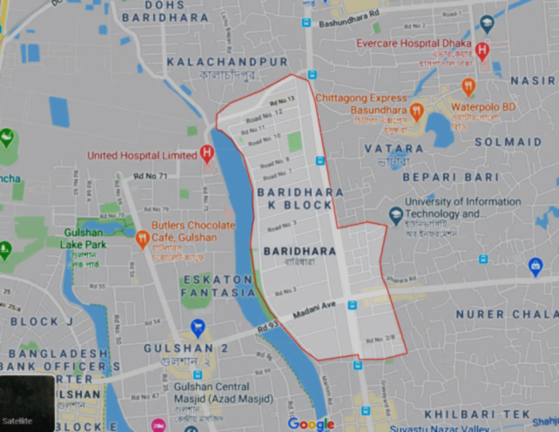
Contact us
Address of office: 12/A K block , Baridhara , Dhaka , Bangladesh. Email: terratrek11@gmail.com Cell: 019………….. 018…………..
Inbox us://Terra Trek Box

Slide 27
Test case table:
Case No | Agent ID | Tourist ID | Case | Step | Expect
01 | ag01 | tr01 | Registration | 1.Username 2.Password 3.NID/BC | Successful
02 | ag02 | tr02 | Log in | 1.Username 2.Password | “
03 | ag03 | tr03 | Visit site | 1.Enter link 2.Database | Running
04 | ag04 | tr04 | Rating | 1.Enter | 5 Star

Slide 28
Traceability Matrix
Traceability | FR.S01 | FR.S02 | FR.S03 | FRS.04
TC01
TC02
TC03
TC04

Slide 29
Conflict Management
Conflict management is the practice of being able to identify and handle conflicts sensibly, fairly, and efficiently.
Analysis: Conflict analysis is the first step in resolving and managing conflict because it enables you to understand the underlying cause of the conflict. Often, the true cause of the conflict is different than what we initially presume. Without a thorough understanding of the base cause of a problem, you will never be able to effectively address it.

Slide 30
Conflict &Mutuality
Category | Conflict | Conflict Mutuality
Package | In package discount some of profile has been approved. And there has many kind of pack. | And there has many kind of pack.
Security | In there need security system | For this we add NID and Birth Certificate document
And there has
Decission Matrix:
 | Solution 1 | Solution 2 | Solution 3
Criteria
 | Solution 1 | Solution 2 | Solution 3
Terra Trek

Slide 31
“Terra Trek” Space in github.com Designed by html.CSS https://terra-trek
“Terra Trek” is coming……

